Slide 1
Customizable Machine Monitoring and Control with Hazelcast Jet
Randy May
22 Apr, 2022

Slide 2
Agenda

Slide 3
Problem Statement
Georgia Automation and Control is implementing a new solution targeted at small to medium factories. The solution will allow an unprecedented level of customization. Customers will be able to set their own alerts, design custom machine control policies and, with minimal help, incorporate new machine types.
They are looking for a robust, scalable event processing engine to be the foundation for their next generation solution.

Slide 4
Problem Statement
Flexibility. It should be possible to implement any policy that can be coded.
Low Latency. Not more than 1 second between stimulus and response.
Scalability. As sensors are added or upgraded, event volume will increase. The solution should scale out gracefully.
Fault Tolerance. Failure of one host must not result in missed signals.
Operates in remote locations outside of the cloud or corporate data center
outside connectivity may be limited or intermittent
machines may have limited footprint
Key Requirements

Slide 5
Company and Platform Overview

Slide 6

Company and Platform Overview
About Hazelcast
Hazelcast is the leading in-memory computing platform that allows organizations to leverage a highly resilient and elastic memory resource for data at rest and in motion. Our technology is behind many of today’s leading financial, e-commerce/retail, telecommunications, healthcare and government organizations. Whether it is real-time inventory and shipping information, lighting quick fraud detection or gleaning insights that lead to product innovation, Hazelcast enables companies to achieve success in microseconds.
Source: https://hazelcast.com/company/

Slide 7
Company and Platform Overview
https://hazelcast.com/customers/
https://hazelcast.com/products/stream-processing/
Customers

Slide 8
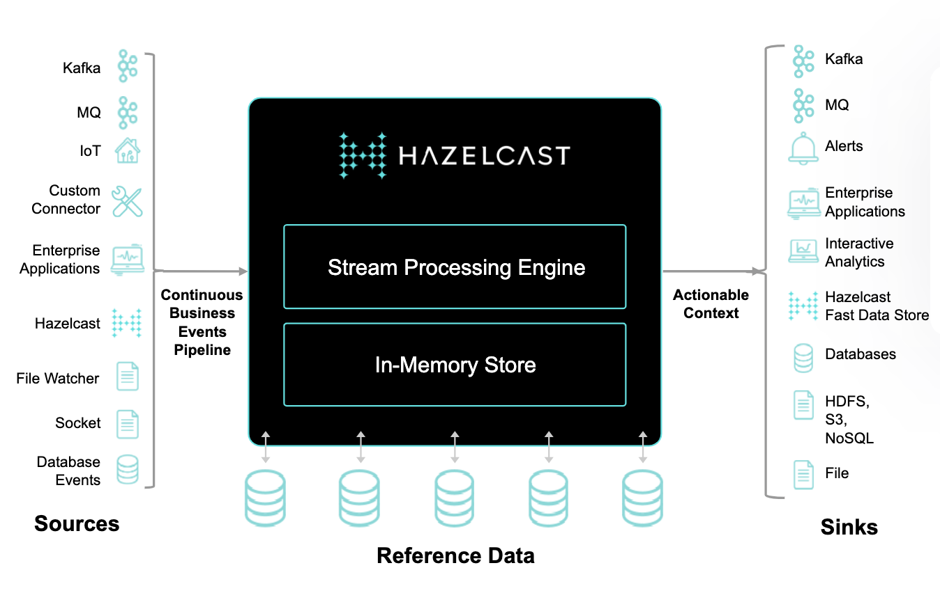
Company and Platform Overview
Stream Processing Reference Architecture
Source: https://hazelcast.com/products/hazelcast-platform/

Slide 9
Technology Overview

Slide 10
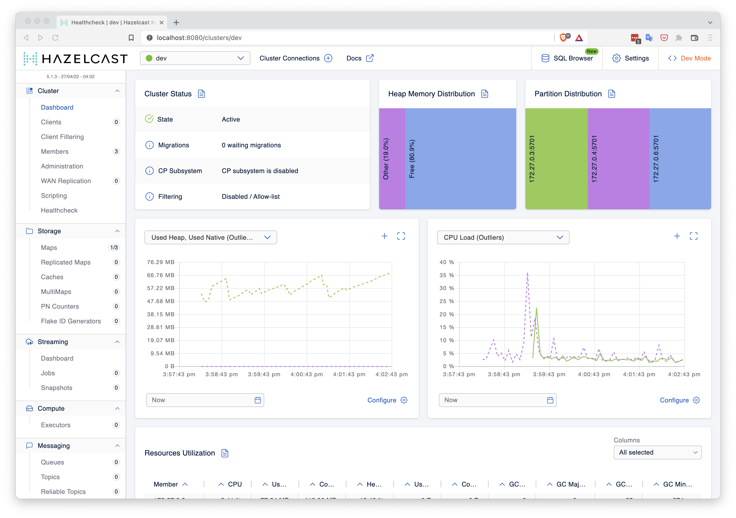
Technology Overview
A short demo in which we …
Have a first look at the UI
Learn about distributed data structures in Hazelcast

Slide 11
Technology Overview
We’ll start with the following simple scenario
Each machine sends a a set of metrics every second, including bit temperature. We want to do the following:
For machines from a particular manufacturer
Every 20 seconds, compute the average temperature over the past 20 second window.
If this average exceeds the allowable limit for that manufacturer, raise an alarm.
How Hazelcast does event processing

Slide 12
Technology Overview
We’ll start with the following simple scenario
Each machine sends a a set of metrics every second, including bit temperature. We want to do the following:
For machines from a particular manufacturer
Every 20 seconds, compute the average temperature over the past 20 second window.
If this average exceeds the allowable limit for that manufacturer, raise an alarm.
How Hazelcast does event processing

Slide 13
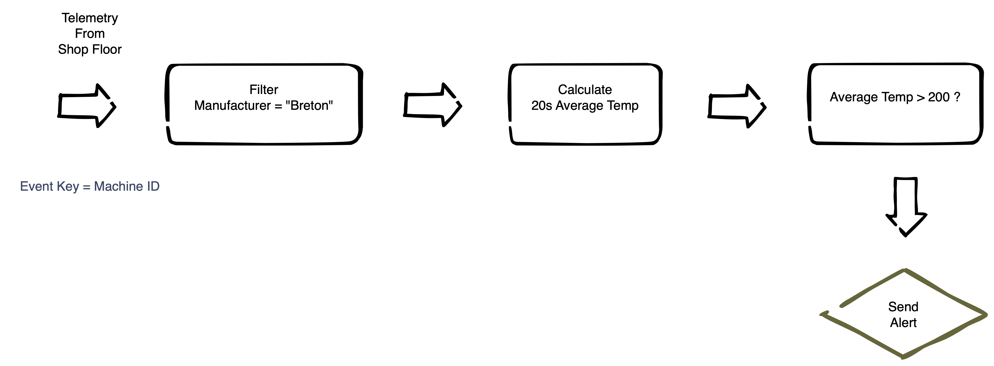
Technology Overview
How Hazelcast does event processing
The job can be understood as a series of simple steps. This is the idea of event processing, but there are significant issues around implementing at scale. For now, notice the following:
Each simple step is a node. Nodes can filter, aggregate and do many other things.
Events flow along vertices. The events coming out of a node may be of a different number and type from the events going in.
Designating a key provides information about how a job can be parallelized.

Slide 14
Technology Overview
How Hazelcast does event processing
Here, describe how the tasks are farmed out to nodes
See Hz resources on this

Slide 15
Technology Overview
The Hz event processing UI

Slide 16
Demo
The scenario
The factory contains a large number of CNC cutting machines. Each machine can report fine-grained data including cutter temperature and also current x, z and z position of the cutter. We want to implement the following policies:
If the cutter temperature reaches a certain threshold, and assuming there are no movement anomalies, send a signal to reduce spindle-speed and feed rate. If the situation does not improve within 1 minute, shut off the machine and raise an alert.
Rapid changes velocity in the xy plane can indicate that the machine has been jarred or a bit has broken. The velocity can be calculated from a recent history of xy positions. This condition should be “turned off” when the z position of the bit indicates that it is above the material thickness for this job. Once the z-position is below the material thickness (i.e. the tool is cutting) then this monitor should become active.

Slide 17
Open Discussion
Questions ?
Next Steps

Slide 18

Thank You!

